Slide 1
KR MANGALAM UNIVERSITY
COMPUTER SCIENCE FUNDAMENTALS
AND CAREER PATHWAYS
Name : Shruti Dolare
Roll no: 2501730066
Course Code: ETCCCP105
Domain: AI/ML
Aim: AI Engineer

Slide 2
01
ARTIFICIAL INTELLIGENCE
Systems that perform tasks requiring human intelligence.
INTRODUCTION
02
MACHINE LEARNING
  Subset of AI focused on learning from data and improving over time.
.
WHAT IS AI-ML?
03
RELEVANCE TO CS FUNDAMENTALS
  algorithms, data structures, probability, linear algebra.

Slide 3
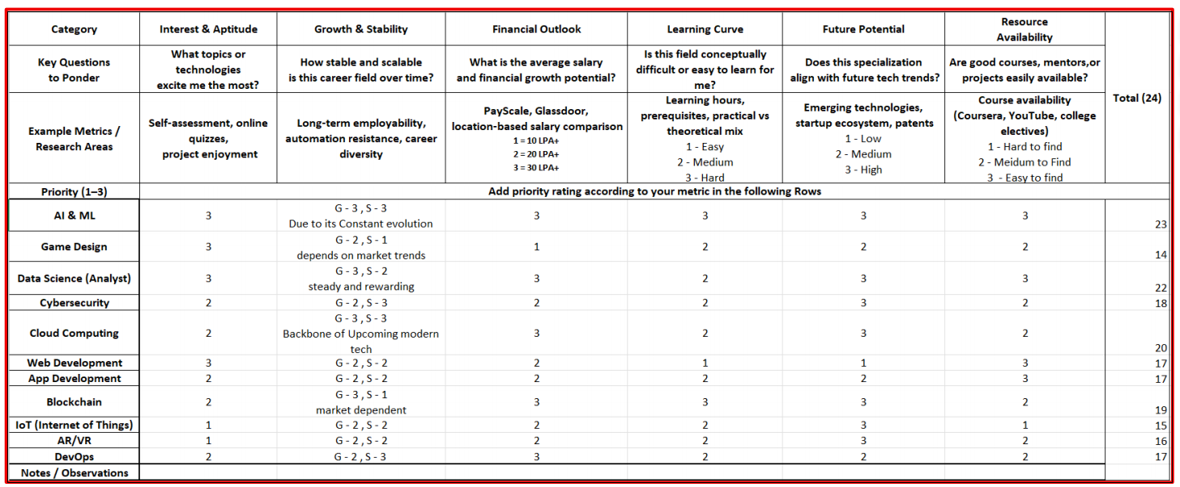
Overview
Enter title
This Template Is Designed By Zuo An,It Will Help You Make You Report Easy And Fast.
Enter title
This Template Is Designed By Zuo An,It Will Help You Make You Report Easy And Fast.

Slide 4
Growth & Stability Job Opportunities &
Financial Outlook
Why AI/ML shows strong growth:
Enter title
Career roles and earning potential
Common roles: ML Engineer, Data Scientist, Research Scientist, MLOps, AI Product Manager.
Salary outlook: among the top-paying CS specializations (entry to senior levels).
Diverse industries: tech, healthcare, automotive (autonomy), finance, startups.
.
  Rapid industry adoption across healthcare, finance, retail, and more.
  Strong research pipeline and continuous innovation (models, transfer learning).
  Stability: demand for ML engineers, data scientists, and MLOps remains high.

Slide 5
Future Potential — Roadmap
Skill progression and milestones:
  - Foundation: strong math (linear algebra, probability), programming (Python).
  - Intermediate: ML algorithms, model evaluation, basic Deep Learning.
  - Advanced: Large-scale ML, MLOps, model interpretability, specialization (NLP/CV).
  - Career paths: research, engineering, product, entrepreneurship.

Slide 6
Comparison Snapshot: AI/ML vs Other Courses
Metric / Course | AI/ML | Data Science | Cyber Security | Cloud Computing | Web Dev | App Dev | Blockchain
Growth & Demand | 9.5 | 8.7 | 7.8 | 8.4 | 7.0 | 7.2 | 6.8
Stability | 8.5 | 8.0 | 9.0 | 8.8 | 7.0 | 7.3 | 6.2
Job Opportunities | 9.2 | 8.9 | 8.0 | 8.6 | 7.5 | 7.8 | 6.5
Financial Outlook | 9.0 | 8.5 | 8.2 | 8.7 | 6.8 | 7.1 | 6.3
Future Potential | 9.6 | 9.1 | 8.4 | 8.9 | 7.2 | 7.4 | 7.0
Work-Life Balance | 6.5 | 6.8 | 6.2 | 6.9 | 7.5 | 7.3 | 6.0

Slide 7
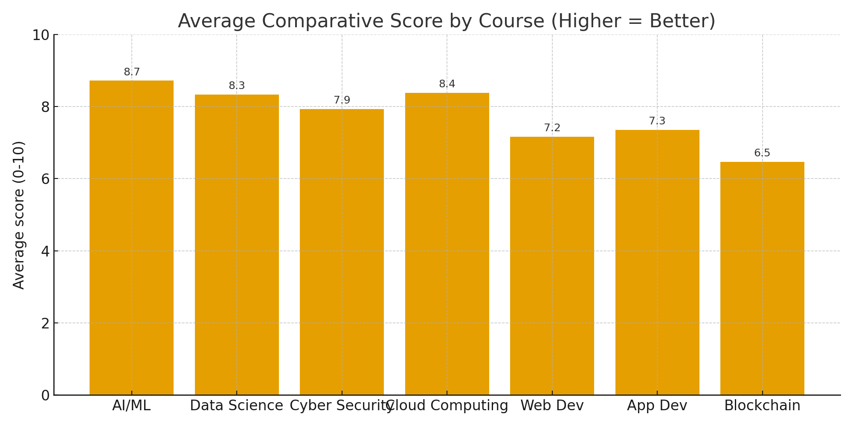
Average Comparative Score by Course

Slide 8
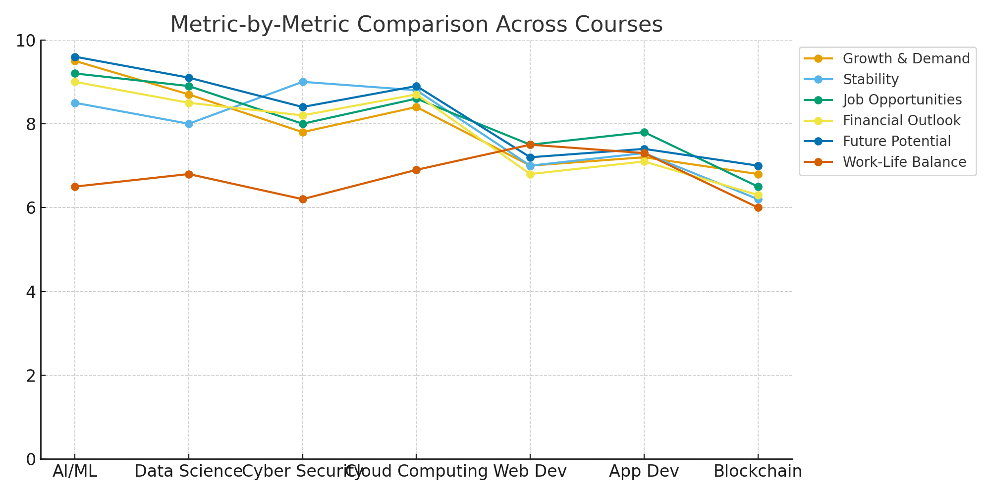
Metric-by-Metric Comparison Across Courses

Slide 9
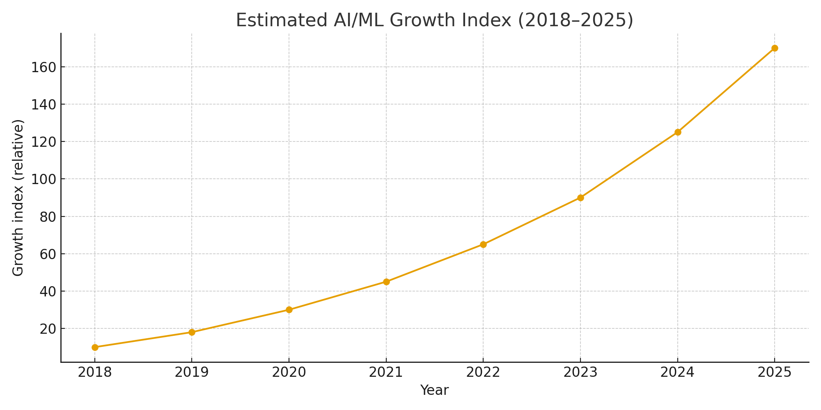
AI/ML Growth Trend (2018–2025)

Slide 10
Why AI/ML Stands Out
- Cross-domain applicability:
01
  impacts nearly every sector.
02
High earning potential and research momentum.
Key strengths:
KEY
STRENGHTS
03
Growing tooling and cloud support
(easier prototyping & scaling).
04
  Broad role diversity: from research to product to infra.

Slide 11
COMPANY COMPARISION:
Company | Skills Required | What They Focus On | How You Grow There | Why It’s Best
Google / DeepMind | Strong maths, ML/DL, Python, TensorFlow, research mindset | LLMs, robotics, healthcare AI, reinforcement learning | Mentorship from top researchers, access to huge datasets, freedom to publish papers | No.1 in AI research, best place for innovation & experiments
OpenAI | Python, PyTorch, NLP, transformer models, super strong problem-solving | Generative AI (GPT, DALL·E, Sora), AGI research | Direct work on cutting-edge models, fast-paced learning, massive compute resources | You literally work on the world’s most advanced AI models
Microsoft | Python, ML, cloud (Azure), data engineering, good software skills | Applied AI, Copilot, Azure AI services, enterprise tools | Solid training, structured career growth, mentorship, real-world deployment | Balanced growth + stability + huge AI ecosystem
Meta (Facebook) | Python, PyTorch, NLP/CV, open-source skills, distributed systems | LLaMA models, social media AI, AR/VR, recommendation systems | ML bootcamps, open-source projects, huge datasets, mixed research + practical work | Best for mixing research + real-world impact
NVIDIA | Python, C++, GPU programming basics, deep learning optimization | AI hardware, model optimization, robotics, autonomous systems | Learn how models run efficiently, deep technical ML expertise | Perfect for hardcore deep learning engineers
Amazon | Python, ML, data engineering, cloud (AWS), problem solving | Alexa, automation, recommendation systems, retail AI | Hands-on ML with millions of users, great data pipelines | Best place to learn real-world ML + data at huge scale
Tesla | Python, computer vision, real-time AI, robotics, CV/DL | Self-driving cars, robotics (Optimus), automation | Fast-paced growth, hands-on projects, reinforcement learning | Best for practical applied AI in physical products
AI Startups | Full-stack ML, Python, deployment (Flask/FastAPI), data pipeline, versatility | Problem-solving, building products fast, end-to-end AI ownership | Learn everything: data → training → deployment, high responsibility | Fastest growth, most hands-on experience, quick promotions

Slide 12
Conclusion & Next Steps
  AI/ML offers strong growth, diverse roles, and high financial upside.
  Suggested next steps: learn math foundations, Python, build projects, participate in competitions, internships.

Slide 13
THANK YOU

